Slide 1
Analyzing the Impacts of Celebrities in Cryptocurrency Market: A Graph Analysis Approach
Wang Qian
Supervised by Prof. He Bingsheng
Evaluated by Prof. Henry Chia
Notes:
Hi Henry. I am Wang Qian. I am very glad to present the progress of my FYP project: Analyzing the impacts of celebrities in cryptocurrency market here today.

Slide 2
Introduction
01
Celebrities’ impact on cryptocurrency market has been significant
Dogecoin price jumped 50% in one day after Elon Musk’s promoting tweet
Machine learning is used to analyze tweets’ sentiment and its relation with cryptocurrency
Graph analysis is used to study properties of the social network
Notes:
Our project is motivated by that celebrities’ impact on cryptocurrency market has been significant in these two years. They utilize social media, such as Twitter, Reddit, YouTube to express their opinions and the opinions spread quickly on the Internet.
For example, Dogecoin’s price jumped 50% in one day after Elon Musk’s tweet: “Dogecoin is the people’s crypto”
Machine learning model is widely used in tweet sentiment analysis. There exists some work on analyzing the relation between tweet sentiments and cryptocurrency market.
And graph analysis has advantages in studying topological and geographical properties of social network.

Slide 3
Introduction
01
A graph analysis model on a real-time updated database
Celebrities’ updates from social media such as Twitter, YouTube, Reddit
Rank celebrities based on their impacts on cryptocurrencies
Price increase of a cryptocurrency each tweet from celebrities can bring
Communities among celebrities
Notes:
Therefore, this project aims to build a graph analysis model on a real-time updated database.
The database contains celebrities’ updates from social media such as Twitter, YouTube, Reddit.
This model can rank celebrities based on their impacts on cryptocurrencies.
One possible criterion is how much price increase of a cryptocurrency each tweet from celebrities can bring
Furthermore, this model helps to detect communities among celebrities based on their updates.

Slide 4
Literature Review
02
Social factor influences
Studies prove relationship between social media and the cryptocurrency
1% increase in Tweets leads to 7% of liquidity improvement in next 5 to 10 min [1]
Twitter sentiment predict the returns of Bitcoin [2]
Celebrities’ impacts
Granger-causal relationship proves that Trump’s tweet sentiment’s impacts on Bitcoin’s variables, such as returns, volatility, trading volumes during the pandemic [3]
Significant positive abnormal returns followed Elon Musk’s 47 Twitter events. [4]
Notes:
After deciding the aim of this project, I reviewed some literature related to social factor’s influences on cryptocurrency market, Tweet Sentiment Analysis, and graph analysis.
For social factor influences, various studies examine the relationship between it and the cryptocurrency market. For example, a 1% increase in tweets leads to about 7% of liquidity improvement in the next 5 to 10 min.
Also, Twitter sentiment has predictive power for the returns of Bitcoin.
Celebrities’ impacts are significant. For example, Granger-causal relationship proves that Donald Trump’s tweets sentiment can be a predictive tool for Bitcoin’s variables, such as returns, volatility, and trading volumes during the pandemic [8].
Another example is Elon Musk’s 47 cryptocurrency-related Twitter events were followed by significant positive abnormal returns and trading volume in the market [9]

Slide 5
Literature Review
02
Twitter sentiment analysis
NLP systematic workflow
Collecting text
Tokenizing and pre-processing text
Feature engineering
Training
Graph-based model including Twitter follower graph improving polarity classification [5]
Regression model
SVM and regression models are used to predict Bitcoin prices [2].
Price is positively affected by positive Twitter sentiments in the short run [6].
Notes:
As celebrities share their comments on cryptocurrency on social media, the contents of their sayings are a vital source to analyze. Among all social media, twitter has been well-researched.
Twitter sentiment analysis has systematic research methods. The typical workflow includes collecting text, tokenizing text, preprocessing the sentences by removing stopwords, lemmatization and stemming, feature engineering, training and validating models, and predicting and analyzing results.
Besides machine learning, a Graph-Based model including Twitter followers graph improves polarity classification.
Most research in this area utilizes the regression model to prove causal relationships [4]. For example, SVM and regression models are used to predict Bitcoin prices. The result is that Bitcoin price is positively affected by the positive Twitter sentiments in the short run.

Slide 6
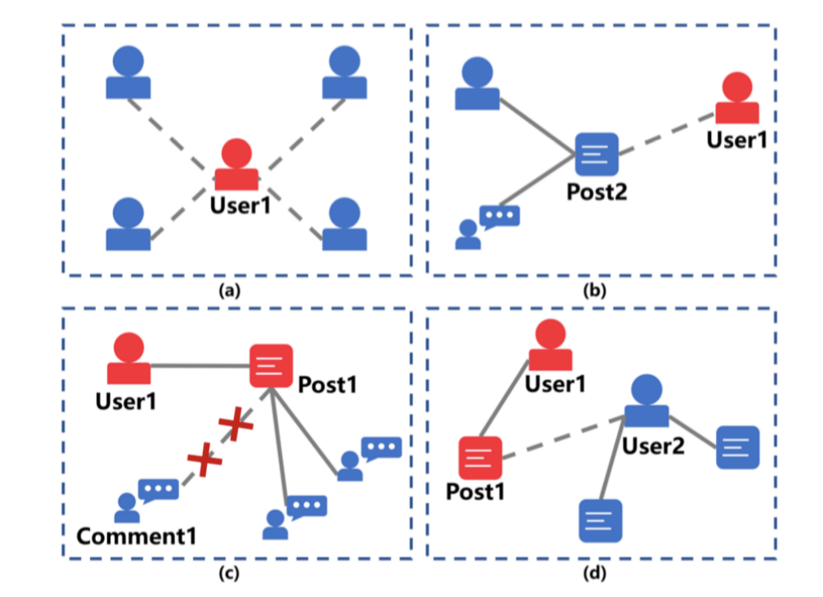
Literature Review
02
Graph analysis
Graph of social media
Users have following relationship
Users can post and repost a tweet
Users can comment a tweet
Notes:
In this subpart, I review graph analysis literature including graphs of social media, PageRank, and Graph Neural Network (GNN) literatures.
Social media’s relation between users can be depicted in a graph shown here. Users have following relationship and they can post and repost a tweet. Also, users can comment a tweet.

Slide 7
Literature Review
02
Graph analysis
PageRank
Centrality is used to define the importance in a graph [7]
EVC to detect most influential nodes within a social graph [7]
Topic-specific scenarios: TwitterRank [8]
Graph Neural Network
Node’s neighbors’ influences are not the same
A prevalent algorithm to detect relationships within nodes in the graph
Recurrent Neural Network(RNN) to model the actions of users and interests in a session
Notes:
Then we need to rank celebrities. PageRank is a famous algorithm to rank web pages utilized by Google. So we can utilize the idea to rank Twitter users. Centrality is used to define the importance of a node in the graph [21]. Among many centrality measures, eigenvalue centrality (EVC) is widely used in social sciences as it is the most successful tool for detecting the influential node(s) within a social graph.
Some approaches improve page ranking algorithms on social media to apply to topic-specific scenarios. For instance, TwitterRank is proposed, similar to PageRank [24]. The difference between this algorithm and PageRank is that this algorithm considers specific topics.
GNN is a prevalent algorithm to detect relationships within nodes in the graph. For a node, neighbors' influences are not the same. Moreover, influences on different topics may be different too. So the influence of friends should not be the same. For context-dependent influences, Recurrent Neural Network(RNN) can be used to model the actions of users and interests in a session.

Slide 8
Literature Review
02
Summary
Use graph to represent social network
Nodes can be celebrities, celebrities’ topics, tweets, cryptocurrencies prices
Edges can be connections between celebrities and celebrities, celebrities and prices
Nodes and edges’ features
Topic-specific PageRank to rank celebrities
Limitations
Without other social media: Reddit, YouTube, Podcast
Top influencers in cryptocurrency market: a new topic
Notes:
From previous work, we know graph is the de facto way to represent social network. Nodes can be celebrities’ accounts, celebrities’ tweets, topics of NFT, cryptocurrencies’ prices, and others. Edges can be connections between celebrities and celebrities, celebrities and tweets, tweets, and cryptocurrencies’ prices.
After constructing graphs, we plan to refer to methods proposed in Twitter sentiment analysis literature, combining machine learning models and graph analysis methods for edges and nodes' features.
Then we can use topic-specific pagerank algorithms to rank celebrities of different topics.
The limitation is that previous work does not consider other social media. However, Reddit has a famous r/CryptoCurrency subreddit which is the leading community in the cryptocurrency market. So, we employ many sources of celebrities’ updates, including Twitter, Reddit, YouTube, and Podcasts.
Also, we aim to build a graph analysis model on a big real-time updated database to recommend top influencers in the cryptocurrency market. It is a new topic in the cryptocurrencies field.

Slide 9
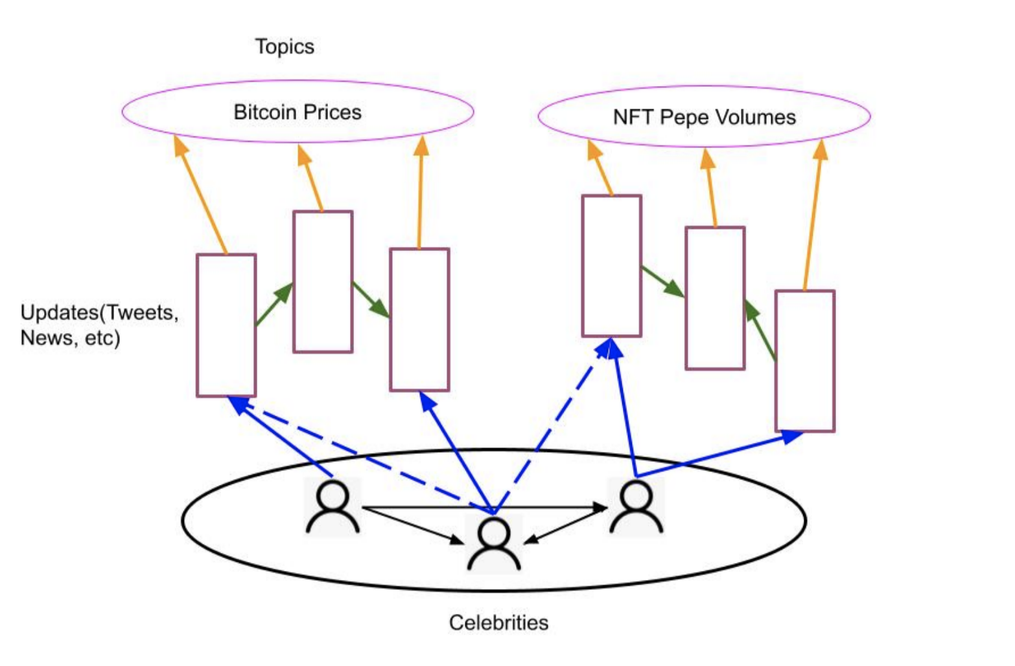
Overview
03
Crawling data
Building graphs
Graph analysis
UI to display results
Notes:
Here, it is the overview of this project. In the bottom cycle, celebrities have following relationship. The rectangle represents celebrities’ updates. Edges from celebrities to updates represent this update is from that celebrity. Updates itself have relationship. For example, one tweet mentions another tweet. Also, updates can be grouped to different topics.
The pipeline of this project is: crawling data, building graphs, doing graph analysis with PageRank and other centrality measures and machine learning models, and building UI to display results responding to users’ requests.

Slide 10
Progress
04
Preliminary investigation
Cryptocurrency dataset: Yahoo Finance, BitStamp, CoinMarketCap
Crawling Twitter:
Open-source modules: e.g. Twint, can’t fetch a complete following list of a user
Twitter official API: strict restriction on number of requests
Web scraping: Selenium with Chromedriver
“Talk is cheap”
Mapping between celebrities cryptocurrency actions and social updates
Notes:
Then I will introduce the progress I have made so far.
At first, we do preliminary investigation. There exist many open-sourced cryptocurrencies datasets. Yahoo Finance provides many coins, such as Bitcoin’s daily open price, close price, and market volume [33]. BitStamp provides free hourly and minutely cryptocurrency data, but the range is restricted to a few cryptocurrencies [34]. To get more detailed information on Bitcoin’s price at a specific minute, CoinMarketCap provides an official API.
There exist many open-sourced cryptocurrencies datasets. Yahoo Finance provides many coins, such as Bitcoin’s daily open price, close price, and market volume [33]. BitStamp provides free hourly and minutely cryptocurrency data, but the range is restricted to a few cryptocurrencies [34]. To get more detailed information on Bitcoin’s price at a specific minute, CoinMarketCap provides an official API.
For crawling Twitter data, there are three methods: using open-sources modules, Twitter's official API, and web scraping tricks. Open-source modules can’t fetch a complete following list of a user. Twitter official API has a strict restriction on number of requests. Web scraping using Selenium with Chromedriver can solve previous two problems. So we choose web scraping as our crawling method.
However, some information on social media is misleading. “Talk is cheap.” Celebrities may spread fake opinions on social media. It is possible to trace Bitcoin addresses using legal analysis [38]. After getting enough addresses, we can do a mapping between celebrities' cryptocurrency addresses and their social accounts to analyze the relations between actions in social media and actions in the cryptocurrency market.

Slide 11
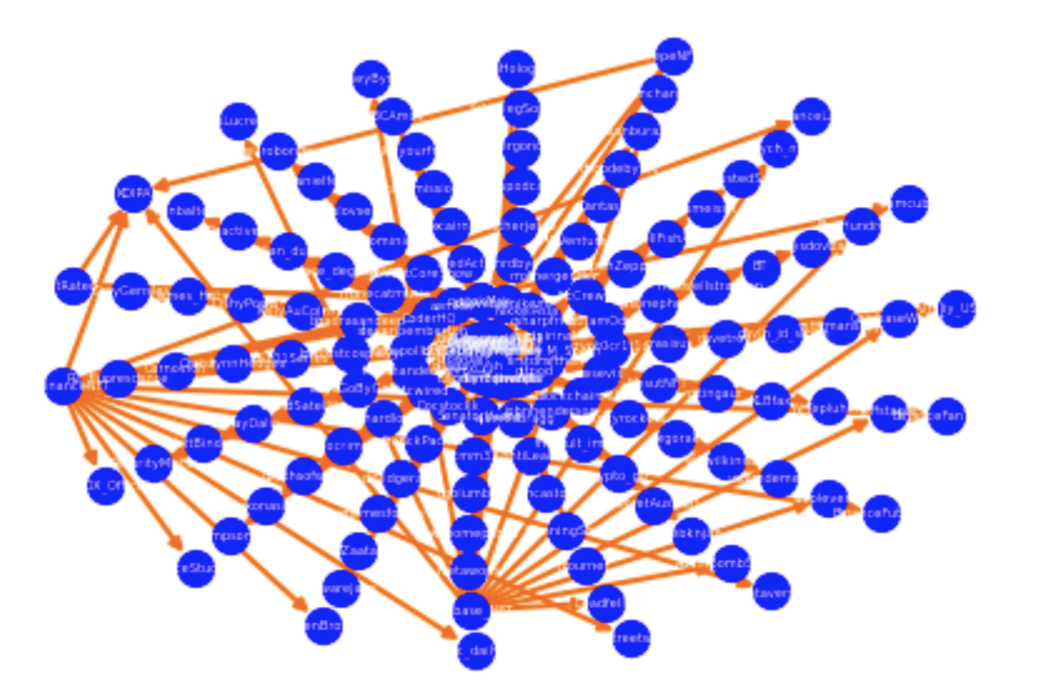
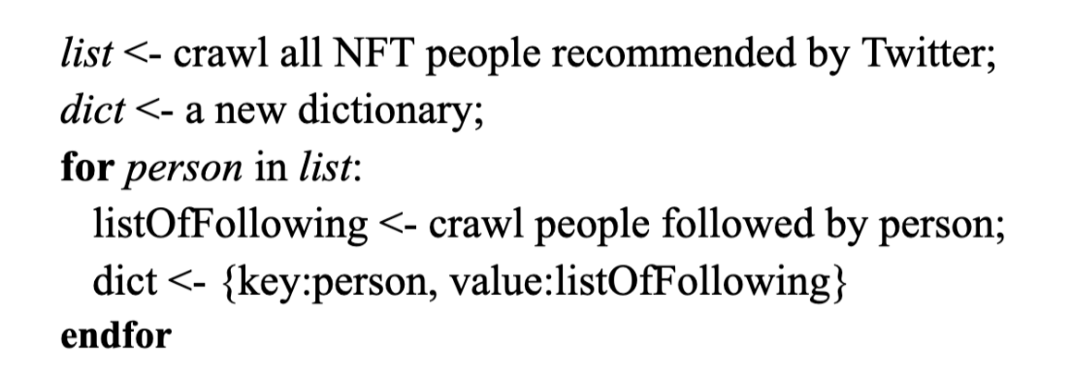
Progress
04
Crawling design
Pseudocode for crawling Twitter’s celebrities
Graph of celebrities’ following relationship
Notes:
Now I want to introduce the crawling design on Twitter.
To choose NFT celebrities, I use the people recommending mechanism on Twitter. Twitter provides an NFT people list after searching the “nft” keyword mainly sorting based on their followers’ number. Then we choose the first 1000 accounts recommended by Twitter as a starting point. Then we write a loop to crawl the following list of these accounts.
Then, we analyze accounts’ influences using a PageRank algorithm. We sample the following relationship of some accounts. In the right figure, nodes represent the Twitter account, directed edges represent following relationship. We can see some nodes are pointed by more points, showing they have more influence than other nodes.

Slide 12
Progress
04
Serverless deploying
Locally crawling is blocked by Twitter
Every hundreds of requests suffer from a frozen time of 15 minutes
Deploy crawling script on AWS Lambda S3
Five same functions to crawl Twitter simultaneously
Trigger events to crawl regularly
Notes:
However, locally crawling suffers from being blocked by Twitter. In experiments, every hundreds of requests suffer from a frozen time of 15 minutes. Then we consider moving crawling from locally to serverless, which can help set triggering events to crawl it continuously and scalably after getting out of freezing. The trick we use is to employ five same functions to crawl Twitter simultaneously.

Slide 13
Progress
04
Summary
A script to automatically crawl users and users' following lists on Twitter
AWS Lambda: crawling Twitter parallelly and regularly
7000 NFT celebrities, 2000 pairs of the following relationship
200 accounts are followed by more than one celebrities
Opensea’s Twitter account is followed by 107 celebrities
Notes:
In summary,
We have developed a script to automatically crawl users and users' following lists on Twitter.
We have deployed the crawling script to AWS Lambda, which allows it to crawl Twitter parallelly and regularly.
We have collected 7000 NFT celebrities from Twitter up to now. Among them, we have collected 2000 pairs of the following relationship. We discover that around 200 accounts are followed by more than one celebrity from the accounts we get. After utilizing PageRank's algorithm, the most influential celebrity is opensea’s twitter account. It is followed by other 107 NFT celebrities.

Slide 14
Plan
05
Summer Vacation
Continue crawling data from Twitter and cryptocurrency market
Celebrities
Celebrities’ tweets
Crawling data from YouTube, Reddit, Podcast
Twitter sentiment analysis
Notes:
For research plan, we will continue crawling data from Twitter, including celebrities and their tweets during summer vacation. Also, we will crawl the cryptocurrency market’s data and extract the existed datasets.
We will also crawl YouTube, Reddit, and other social media’s contents.
Then we will do Twitter sentiment analysis on celebrities’ tweets.

Slide 15
Plan
05
Next Semester
Graph analysis: PageRank algorithms, Topic-Specific PageRank Algorithm, GNN
Interactive tool. e.g. Website, Dashboard, Python module
Notes:
In the next semester, we will do more on graph analysis. We will utilize the PageRank algorithm, topic-specific pagerank algorithm, GNN to analyze the critical celebrities in NFT and other topics.
At last, after we finish the graph analysis model, we will develop an interactive tool, maybe a website or a python module, for users to search cryptocurrency topics they are concerned about and then return top influencers and corresponding information.

Slide 16
References
06
1. Choi, H. (2021). Investor attention and bitcoin liquidity: Evidence from bitcoin tweets. Finance Research Letters, 39, 101555.
2. Kraaijeveld, O., & De Smedt, J. (2020). The predictive power of public Twitter sentiment for forecasting cryptocurrency prices. Journal of International Financial Markets, Institutions and Money, 65, 101188.
3. Huynh, T. L. D. (2021). Does bitcoin react to Trump’s tweets?. Journal of Behavioral and Experimental Finance, 31, 100546.
4. Ante, L. (2021). How Elon Musk's twitter activity moves cryptocurrency markets. Available at SSRN 3778844
5. Speriosu, M., Sudan, N., Upadhyay, S., & Baldridge, J. (2011, July). Twitter polarity classification with label propagation over lexical links and the follower graph. In Proceedings of the First workshop on Unsupervised Learning in NLP (pp. 53-63).
6. Georgoula, I., Pournarakis, D., Bilanakos, C., Sotiropoulos, D., & Giaglis, G. M. (2015). Using time-series and sentiment analysis to detect the determinants of bitcoin prices. Available at SSRN 2607167.
7. Ilyas, M. U., & Radha, H. (2011, June). Identifying influential nodes in online social networks using principal component centrality. In 2011 IEEE International Conference on Communications (ICC) (pp. 1-5). IEEE.
8. Weng, J., Lim, E. P., Jiang, J., & He, Q. (2010, February). Twitterrank: finding topic-sensitive influential twitterers. In Proceedings of the third ACM international conference on Web search and data mining (pp. 261-270).

Slide 17
THANK YOU
Notes:
This is the end. Thank you so much for your time.

